Slide 1
Database Design Chat 002
Why do we build databases anyhow?

Slide 2
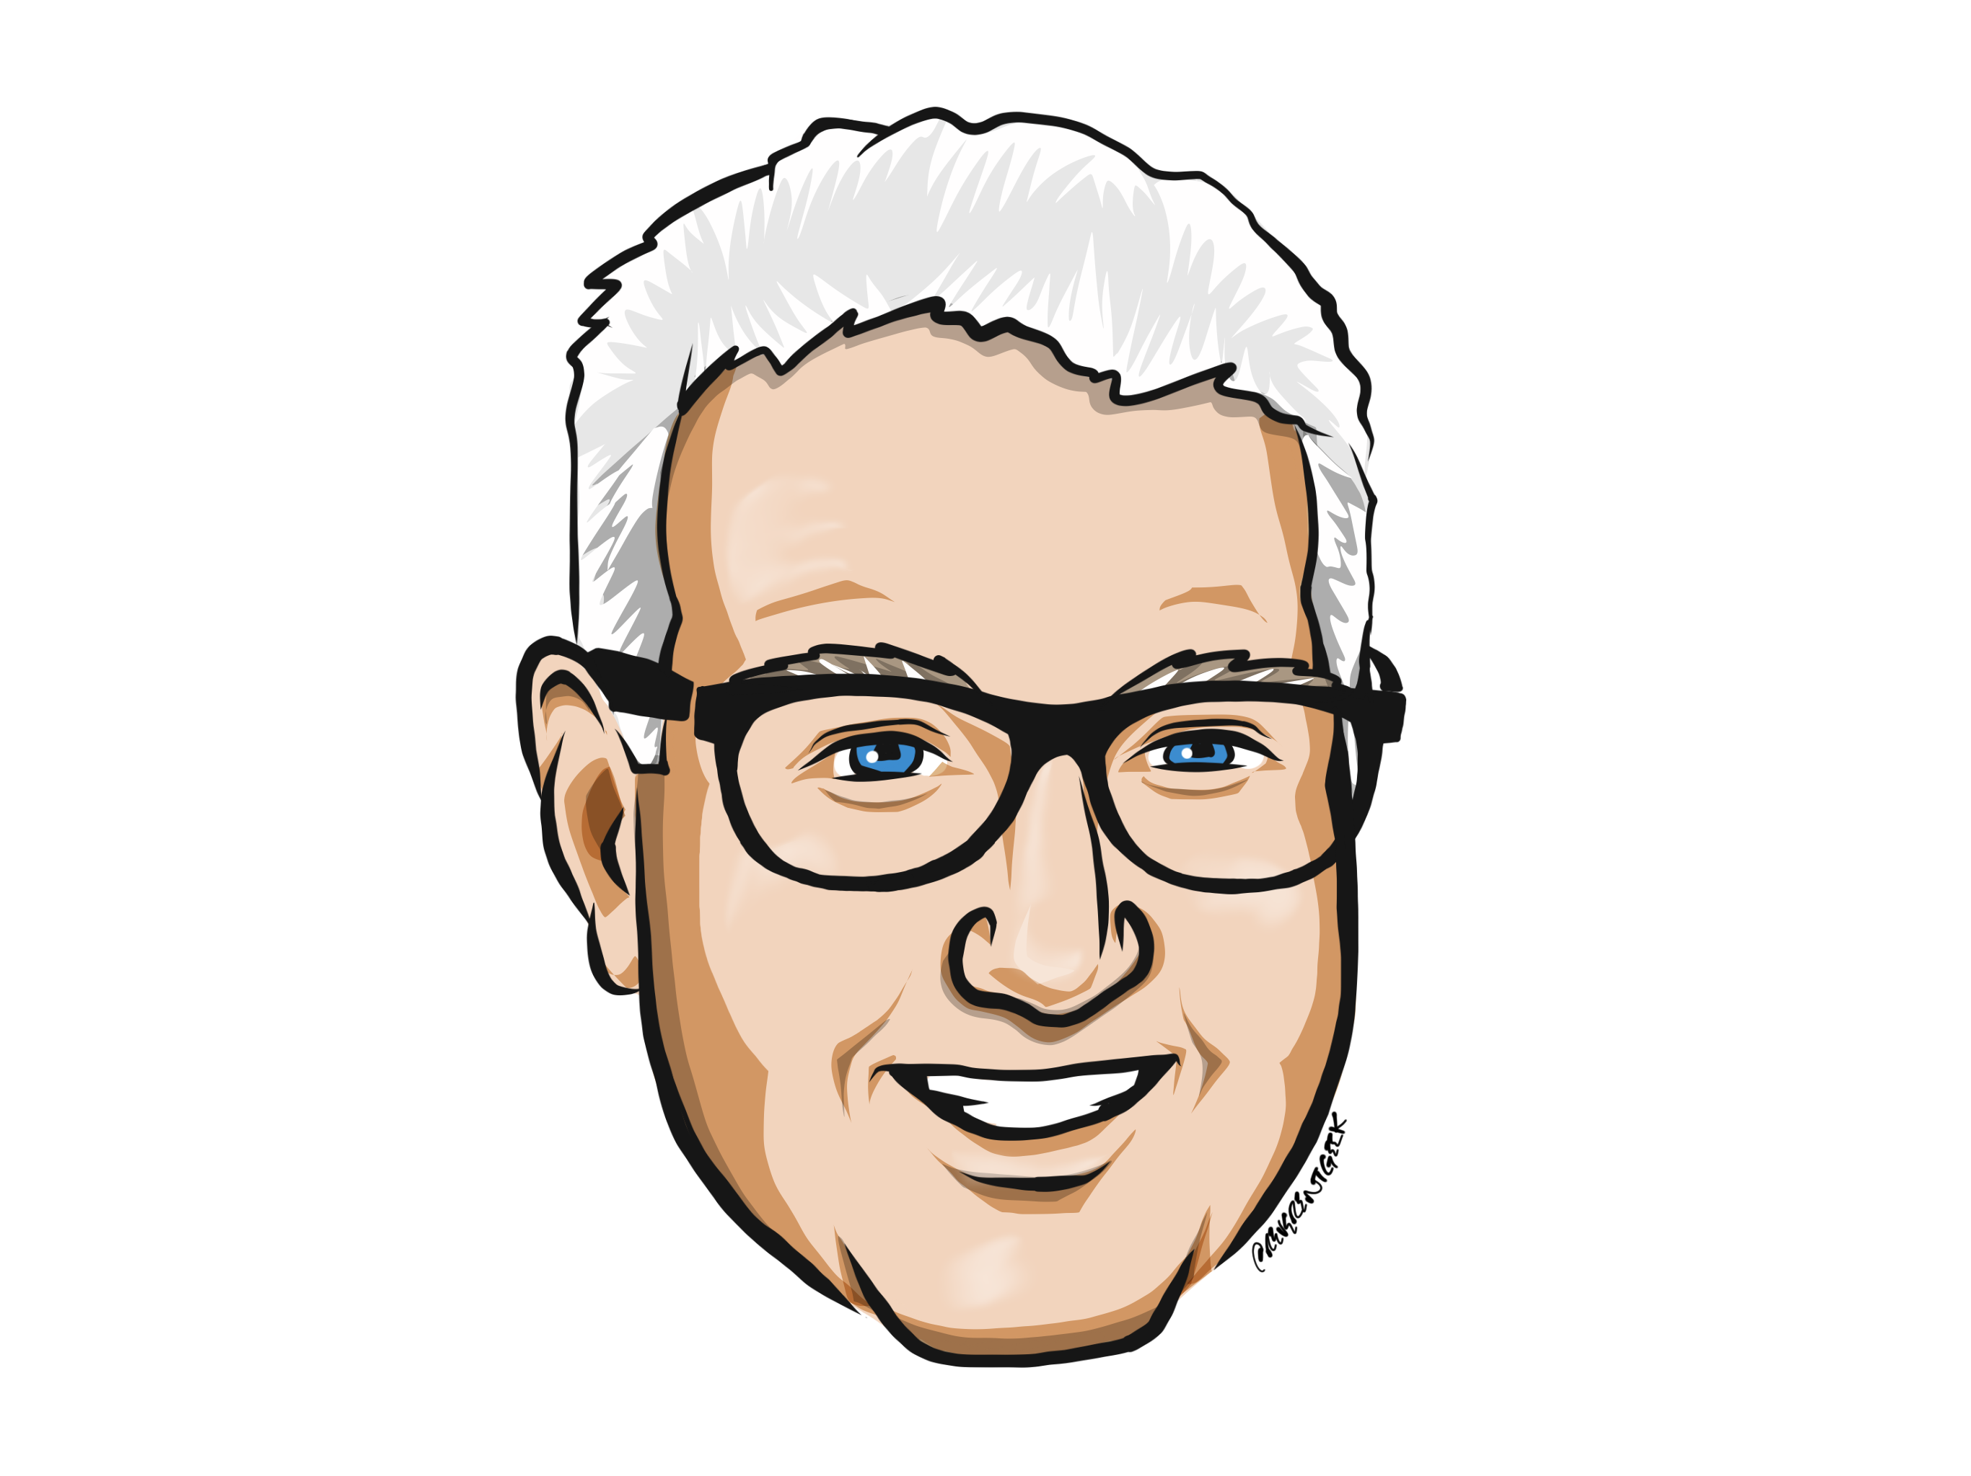
About Me
https://linktr.ee/drsql

Slide 3

Pay Taxes
Most steps make
MORE data
Follow On Actions
Analyze History
Store Data
Execute Business
Fix future issues
Report Business
Marketing
This Photo by Unknown Author is licensed under CC BY

Slide 4
Until next time…
Remember that correctness is the most important goal
Yet, it doesn’t end with storing a value and being able to retrieve it somehow
The database is the keeper of history for the customer (and the tax person)
Understand the problem first, then solve it!

